Slide 1

Innovix
SharedRide

Slide 2
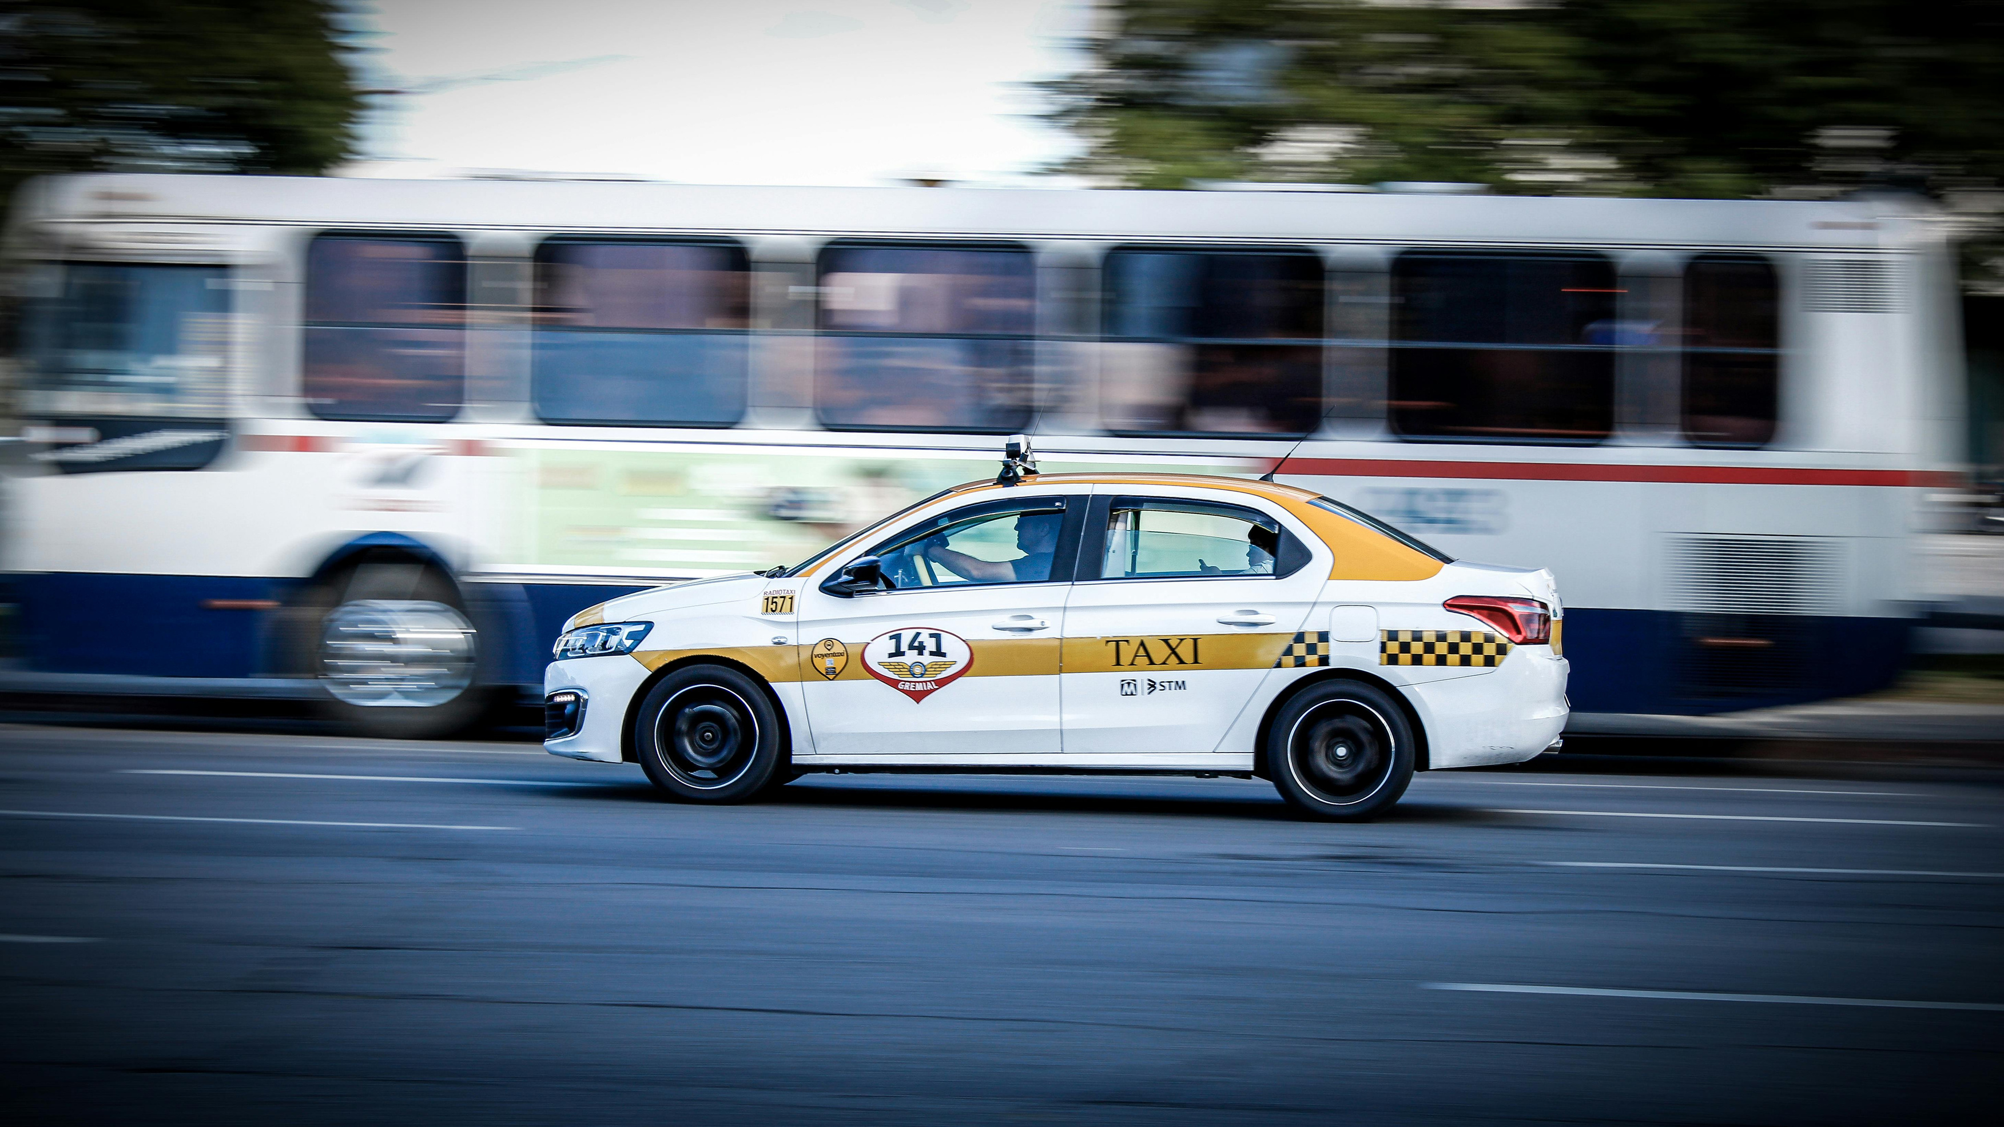
Agenda
01
02
03
04
05
06
07
08
09
10
Problem Statement
Solution
Target Market
Business logic
Implementation
Product Vision
MVP
Go To Market Plan
Business
Goal

Slide 3
Problem Statement
1. High Travel Cost And Inflection
Rising fuel prices have significantly increased taxi fares.
Daily commuting has become unaffordable for employees and regular travelers.
2. Overcrowded Public Transport
Public buses are often overcrowded and time-consuming.
Delays reduce convenience and lower overall productivity.
3. Inefficient Vehicle Utilization
Most taxis carry only one passenger (Single Occupancy).
This leads to traffic congestion, higher fuel costs.

Slide 4
Solution
Automated Smart Matchmaking
The AI engine instantly groups 3–4 passengers with similar routes and schedules into one vehicle.
Dynamic Waypoint Optimization
The system automatically generates the most efficient pickup points without causing delays or route deviations.
Seamless Shared Transit
Synchronizes passenger demands in real-time to maximize vehicle occupancy while maintaining individual passenger convenience.

Slide 5

Target Market
01
Corporate officers, tech professionals, and multinational staff. They possess steady monthly disposable income, prioritize comfort. (9-5 employees)
02
Higher-education students traveling during specific class intervals who cannot afford standard taxi rates but require safety, speed, and punctuality.

Slide 6
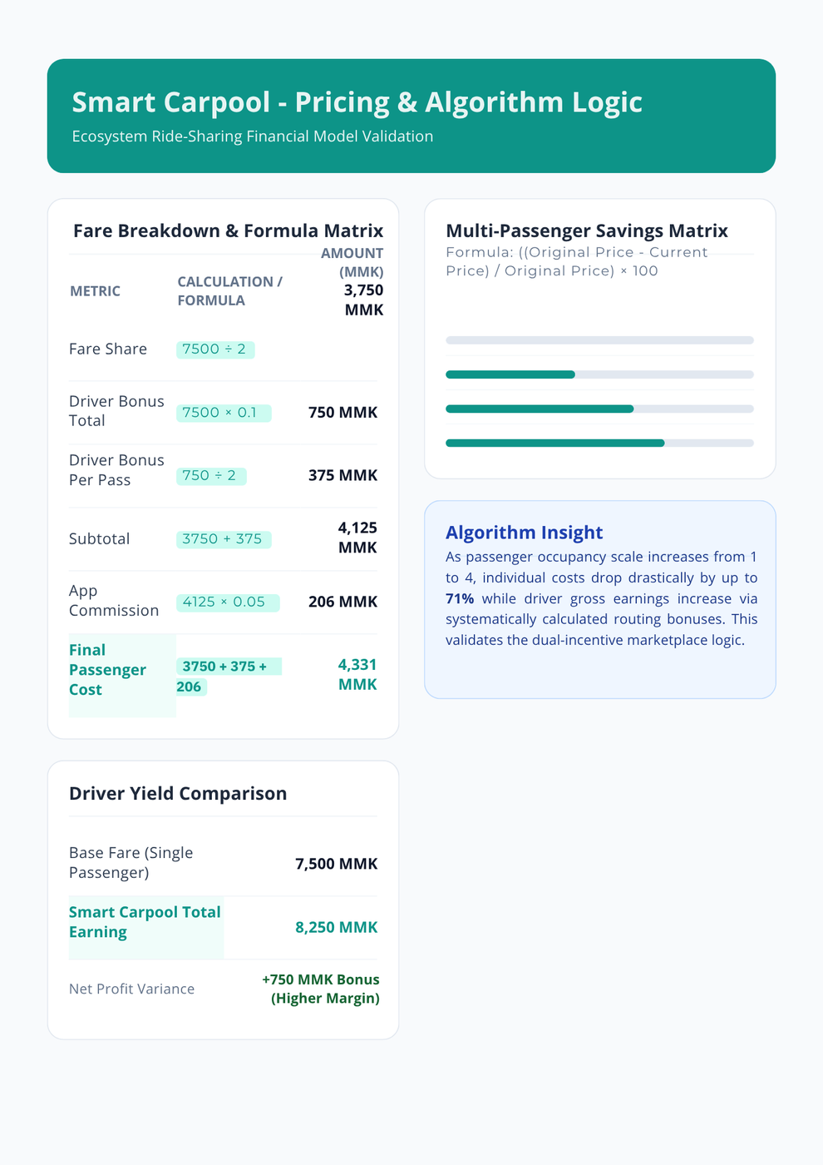
Business Logic

Slide 7
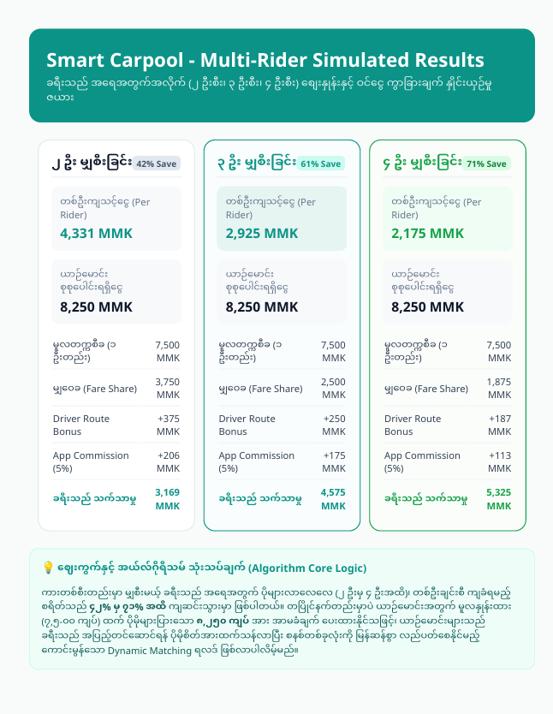
Business Logic

Slide 8
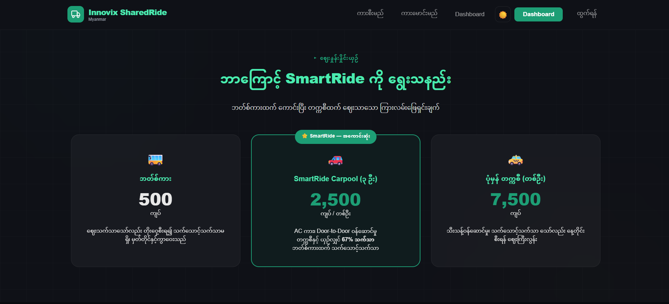
Implementation

Slide 9
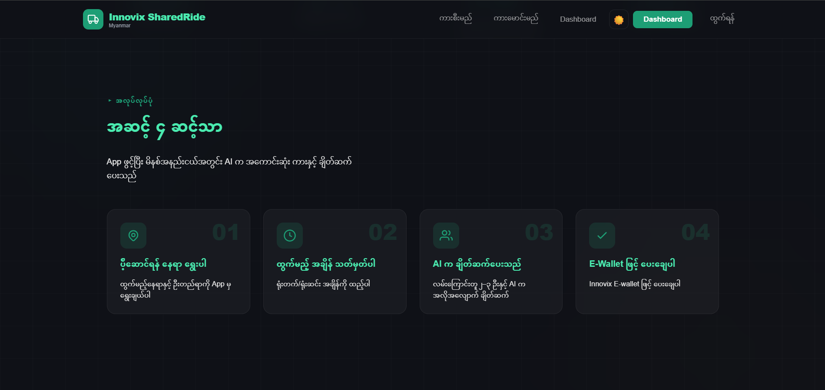
Implementation

Slide 10
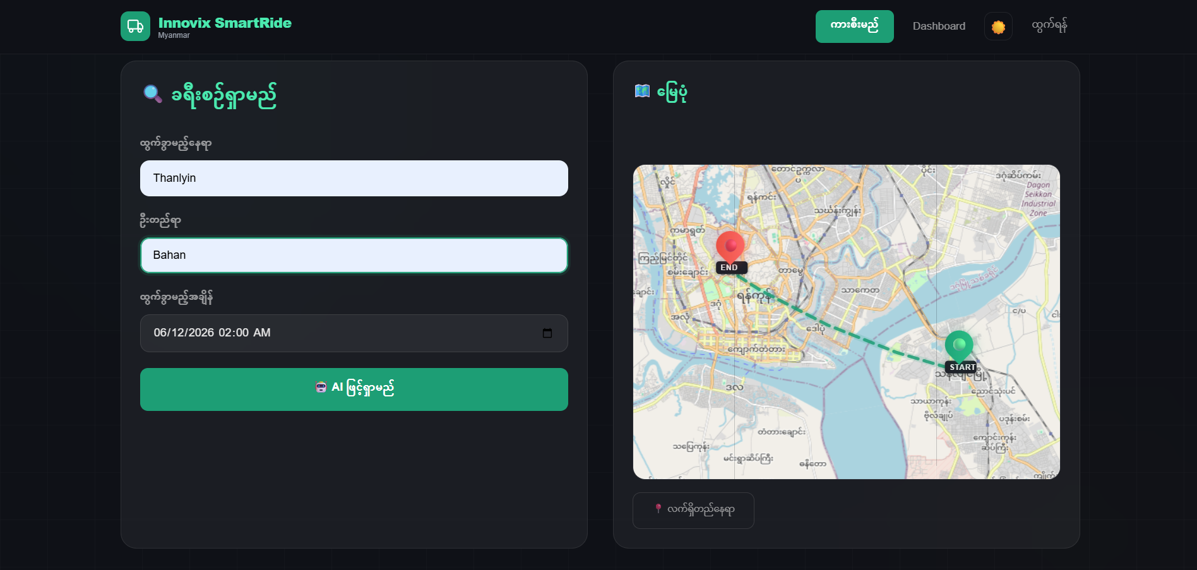
Implementation

Slide 11
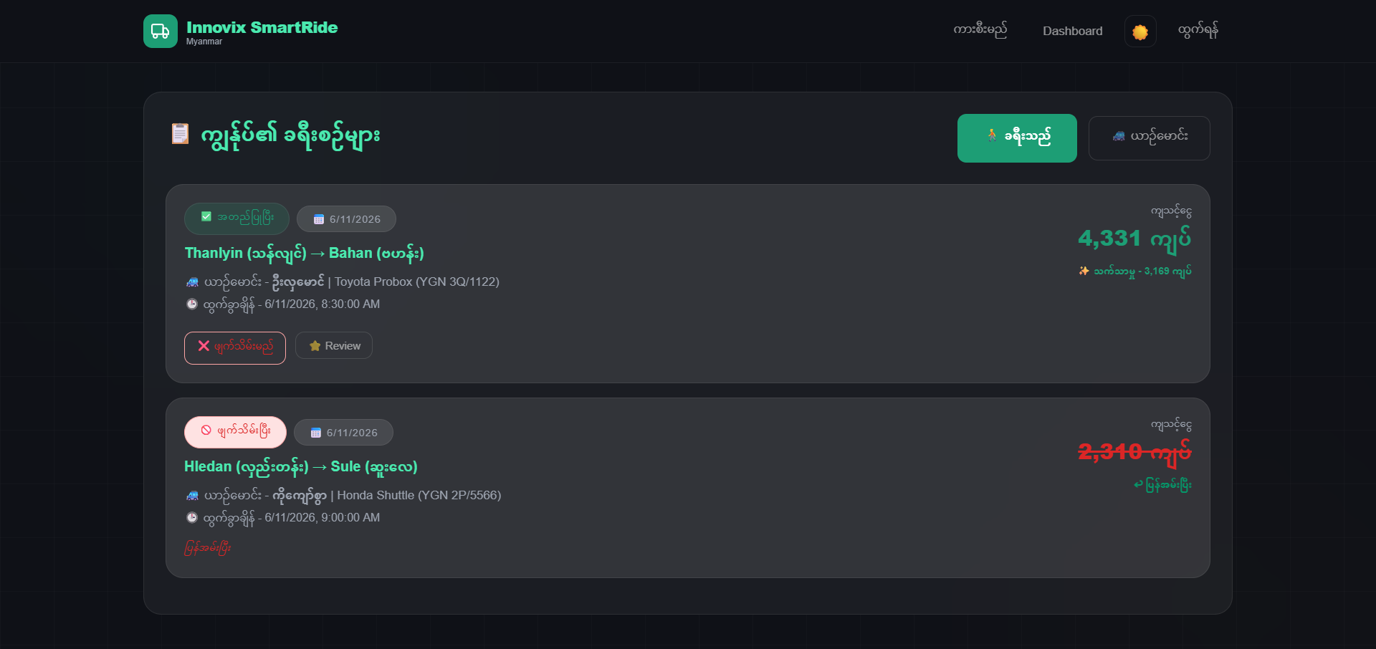
Implementation

Slide 12
Product Vision
Smart Shared-Route Carpooling is an AI-powered mobility platform designed to make daily transportation more affordable, convenient, and efficient. By matching passengers with similar routes, the platform reduces travel costs, improves driver earnings, and maximizes vehicle utilization, creating a sustainable and smarter urban transportation ecosystem
ra

Slide 13
MVP
Lean Platform-Viber/Telegram Bot or simple web landing page.
Single Route Validation-Launch on one high-demand commuter route.
Manual Ride Matching-Passenger matching managed through simple backend tools.
Verified Driver Pool-Start with 5–10 trusted and verified drivers.
Low-Cost Operations-Minimize development costs while

Slide 14
Go To Market Plan
Phase 1 B2B Partnerships (First 30 Days)
Partner with companies and banks to offer employee commute solutions.
Phase 2: Referral Growth
Drive user acquisition through referral rewards and free ride incentives
Phase 3: Digital Marketing
Use Facebook and TikTok ads targeting daily commuter pain points.

Slide 15
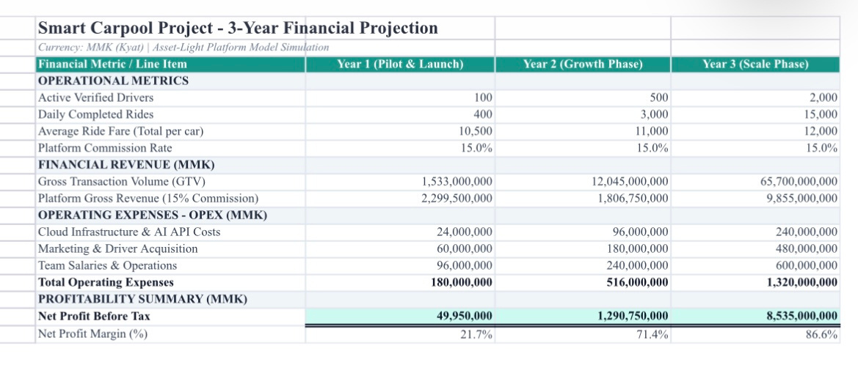
Financial Projection Table

Slide 16
Our Goals
01
Riders: Up to 65% lower travel costs with AI-powered shared rides.
02
Drivers: Higher earnings through multiple passengers per trip.
03
Platform: Asset-light model with recurring revenue from a 15% commission
Core Summary: The Win-Win-Win Transit Ecosystem

Slide 17
Tech Stack
Frontend-
HTML
CSS
JavaScript
Maps & Location
Leaflet
OpenStreetMap
Data Storage & Dev Tools
Browser Local Storage
Visual Studio Code

Slide 18
Thank You!
Contact Us
Phone
09773403055
Mail
innovixshareride@gmail.com
Website
www.shareride.com
Address
Everest Cantu
MICT park building 10, 5th floor

